Slide 1
movie recommender
Project 4
Team: Hinley Fung & Ngoc-Tran Nguyen

Slide 2

Hypothesis
Tired of rewatching “The Office” for the 12th time? Looking for your next binge-worthy series or docudrama? With the vast number of movies, TV shows, and streaming services available today, people have more access to different types of entertainment than ever before. Using this interactive dashboard, movie buffs and casual viewers alike can find new shows to watch based on recommendations from like-minded film fanatics.

Slide 3

Datasets
https://grouplens.org/datasets/movielens/
https://www.kaggle.com/tmdb/tmdb-movie-metadata

Slide 4

Programing Libraries/ Requirements
Machine Learning
HTML/ CSS/Bootstrap
Python Pandas
Sklearn
Flask
Gunicorn

Slide 5
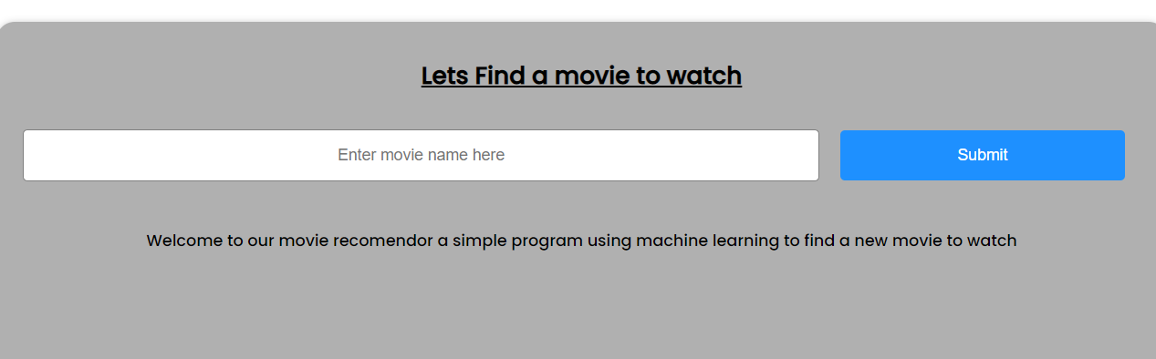
Walk Through
Give us a movie you like!

Slide 6
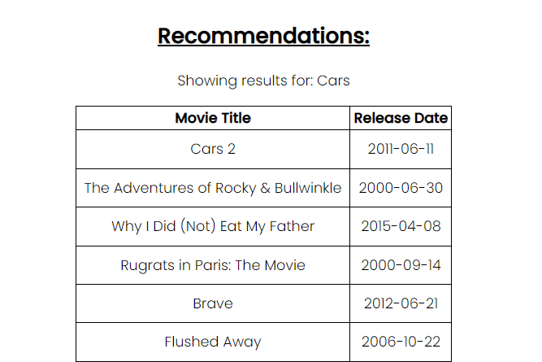
Walk Through
After entering a title, you’ll be brought to a page returning the top 10 movies recommended for you

Slide 7
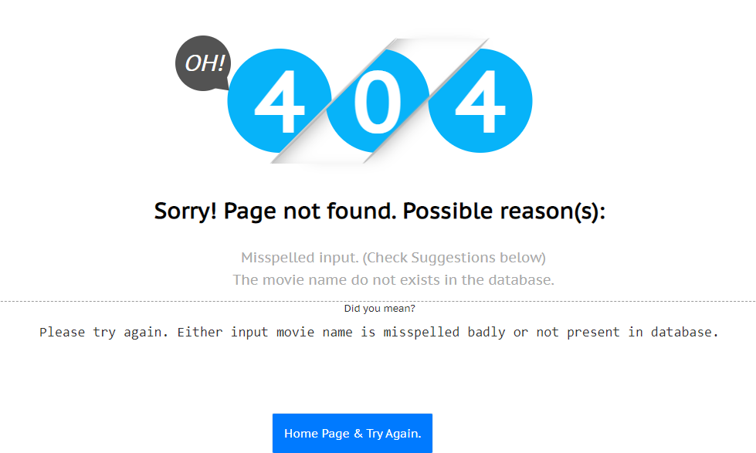
Walk Through
If your title is not found, you’ll be redirected to a page containing possible explanations and workarounds

Slide 8
Bugs and Moving forward
Movie data set was too large which needed compressing
API key request took a while to approve
Add an autofill feature to avoid any input errors
If given more time, we would implement data directly from the TMDB API
Retrieve TMDB links for individual movies

Slide 9
Any Questions?
Link to our website on Heroku:
https://hf-movie-rec.herokuapp.com/

